Slide 1


Slide 2
Tech Mahindra
2016

Slide 3
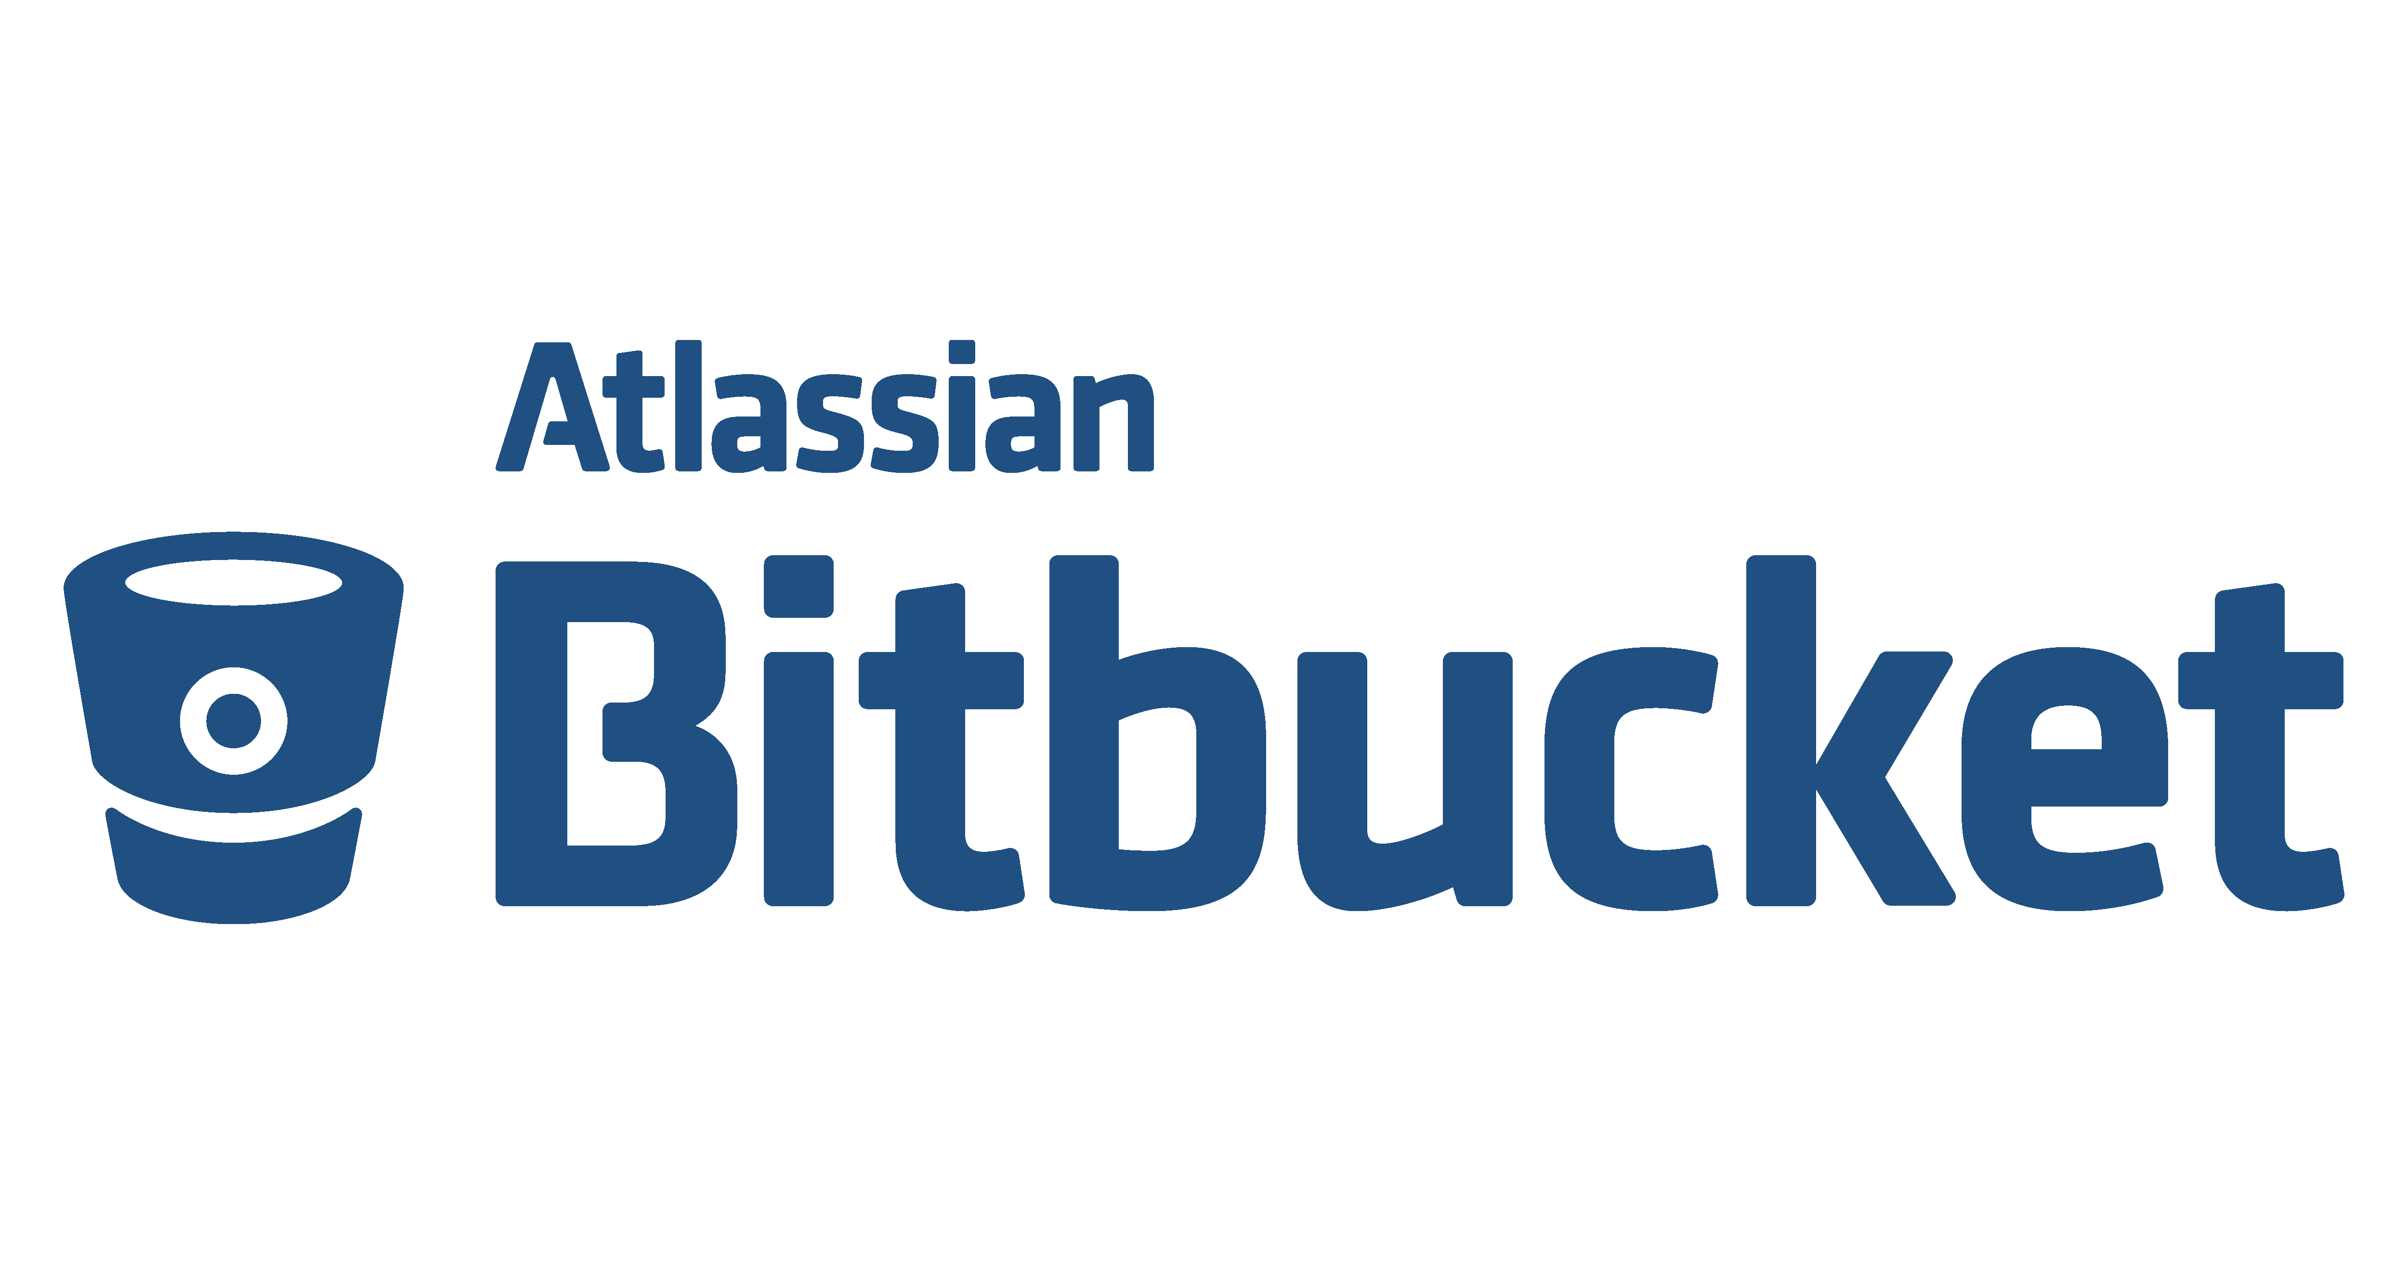
Content
Introduction
History
Features
Advantages and disadvantages
Comparison with counterparts
Installation
Sample demo
Conclusion

Slide 4
Introduction Bitbucket is a web-based hosting service for projects that use either the Mercurial or Git revision control systems. Bitbucket offers both commercial plans and free accounts. It offers free accounts with an unlimited number of private repositories for upto 5 users and public repositories for all. Bitbucket is written in Python using the Django web framework.

Slide 5
History Bitbucket was previously an independent startup, founded by Jesper Nohr. On 29 September 2010, Bitbucket was acquired by Atlassian. Initially, Bitbucket only offered hosting support for Mercurial projects but on 3 October 2011, it officially announced support for Git hosting. In September 2015, Atlassian renamed their Stash product to Bitbucket Server.

Slide 6
Features
Cloning-When you want to work on a project by changing its files or adding new files, you need to clone your project to your local system.
Branching-(fork/main repo →branch) Branching offers a way to work on a new feature without affecting the main codebase.
Forking-A fork is really a Github (not Git) construct to store a clone of the repo in your user account. As a clone, it will contain all the branches in the main repo at the time you made the fork.
Pull Requests-Pull requests let you tell others about changes you've pushed to a GitHub repository. Once a pull request is sent, interested parties can review the set of changes, discuss potential modifications, and even push follow-up commits if necessary.

Slide 7
Commit-A commit is a set of changes to the code. This is one of the most interesting things about Git. You don't transfer files, you transfer logs of changes.
Merging-when we make a pull request with hot fixes, it goes on our production branch. When we accept the pull request, we go to the compare view and merge production(forked) into our staging(main) branch, making sure the fix makes it out both externally and internally.

Slide 8
Advantages and Disadvantages
Advantages:
→Free unlimited private repositories for small teams
→Integrated issue tracking system
→Multiple authentication methods
→JIRA integration
→Supports hosting static websites
→Allows importing existing repositories
→Backed by a trustable company that has proved it's worth
Disadvantages:
→Private repositories are free for only 5 users
→No code search
→Not as stable as github

Slide 9
Comparison with counterparts
If price is not an issue, and one don’t mind closed-source, and is OK with its installation options, choose GitHub Enterprise Edition.
If you must have everything Atlassian, choose BitBucket Server. Bitbucket integrates very well with JIRA, a popular project and issue-managing app.
Everyone else should go with GitLab. It’s a great product, it’s open source with the enterprise offering, its pricing is reasonable and there’s nothing it lacks when compared to GitHub.

Slide 10
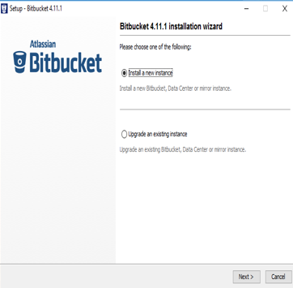
Installation Download url- https://www.atlassian.com/software/bitbucket/download

Slide 11
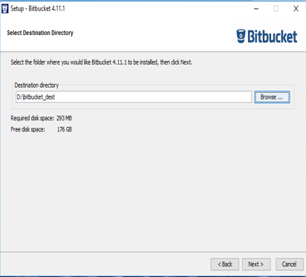

Slide 12
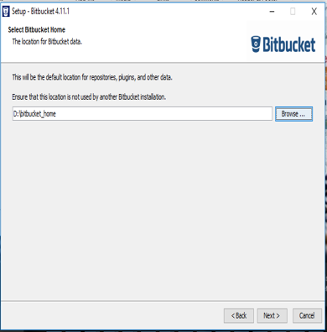

Slide 13
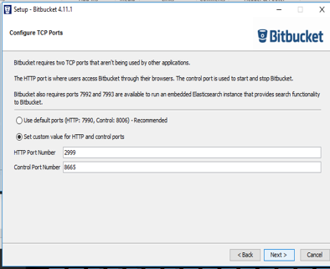

Slide 14
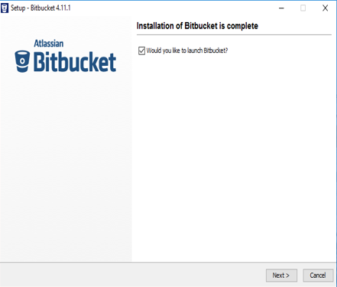

Slide 15
Sample application
Code review using Bitbucket.
Steps involved-
Fork the repository to copy it to your own account.
Clone the forked repository from Bitbucket to your local system.
Make changes to the local repository.
Push the changes to your forked repository on Bitbucket.
Create a pull request from the original repository you forked to add the changes you made.
Wait for the repository owner to accept or reject your changes.
If a repository owner accepts the pull request, Bitbucket merges your code changes into the original repository.

Slide 16
Pusing the project to remote repository from the local system: In the cmd and perform the following steps- →go to project base destination path and initialize Git Repository using git init command. →add Files in the project to repository using git add --all command → to add a message for this particular task (pushing the code to remote repo)git commit –m “msg” command →add the origin to the git using git remote add repositoryUrl command →finally, push the code to the remote repository using git push repositoryUrl master command After performing these steps the project is finally pushed to the remote repository.

Slide 17
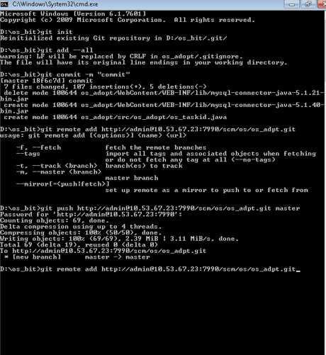
Pushing the code to remote repo

Slide 18
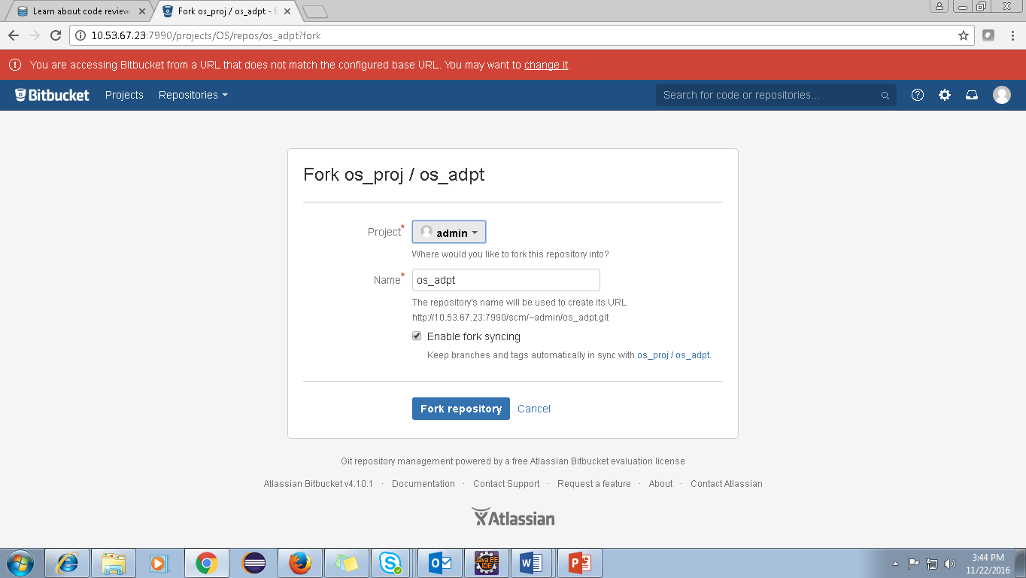
Code Review Process
Fork the repository to copy it to your own account.

Slide 19
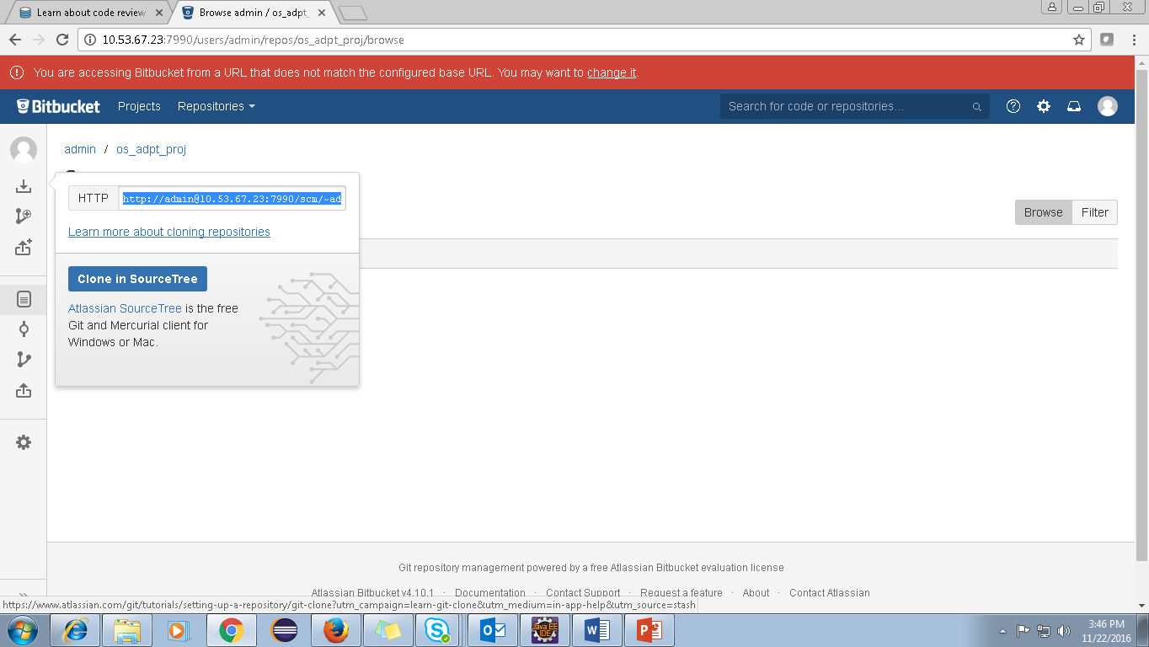
Clone the forked repository from Bitbucket to your local system.

Slide 20
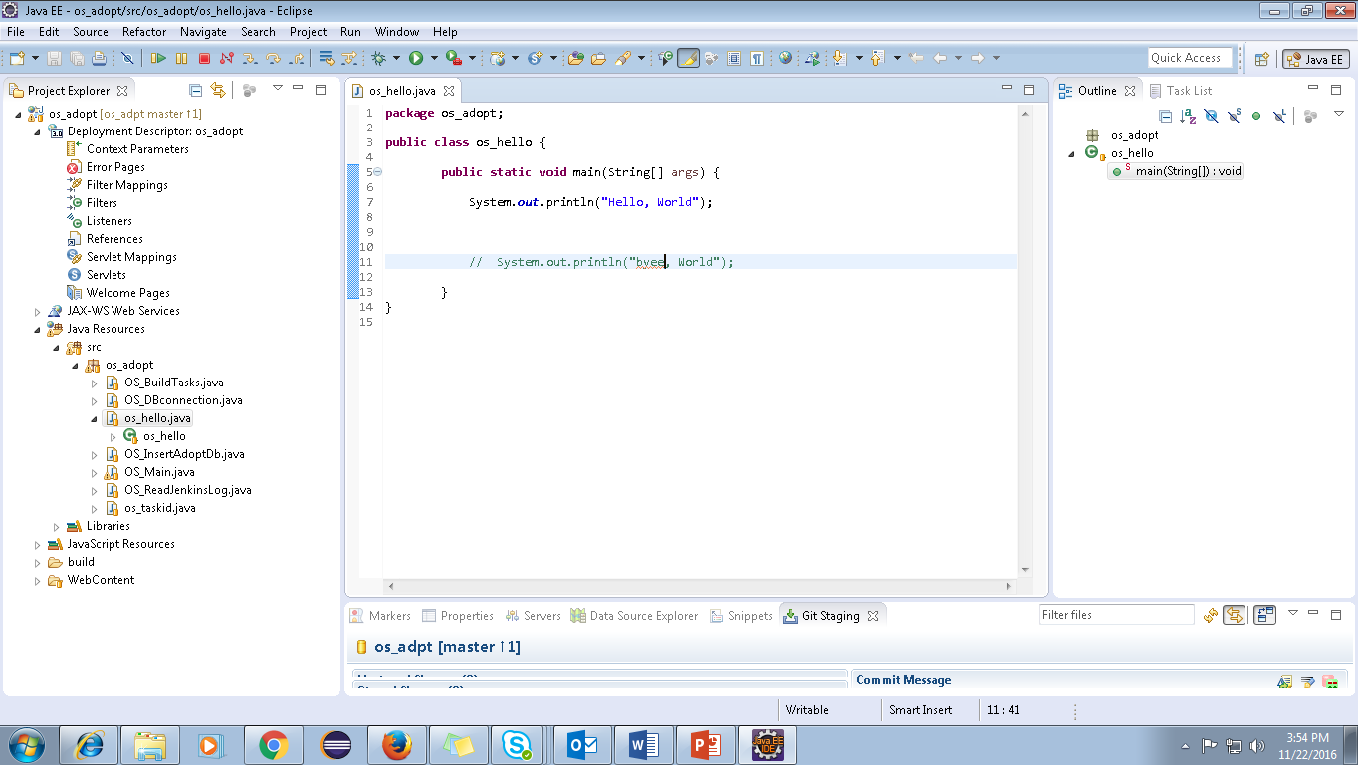
Make changes to the local repository.

Slide 21
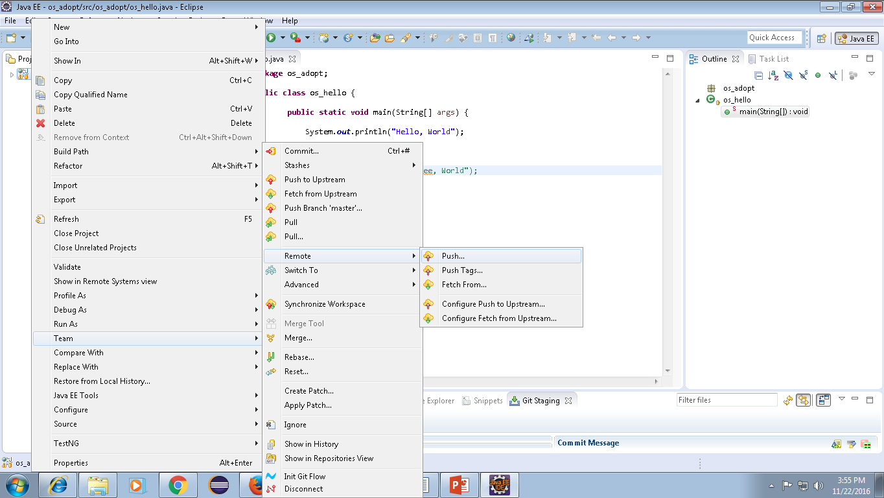
Push the changes to your forked repository on Bitbucket

Slide 22
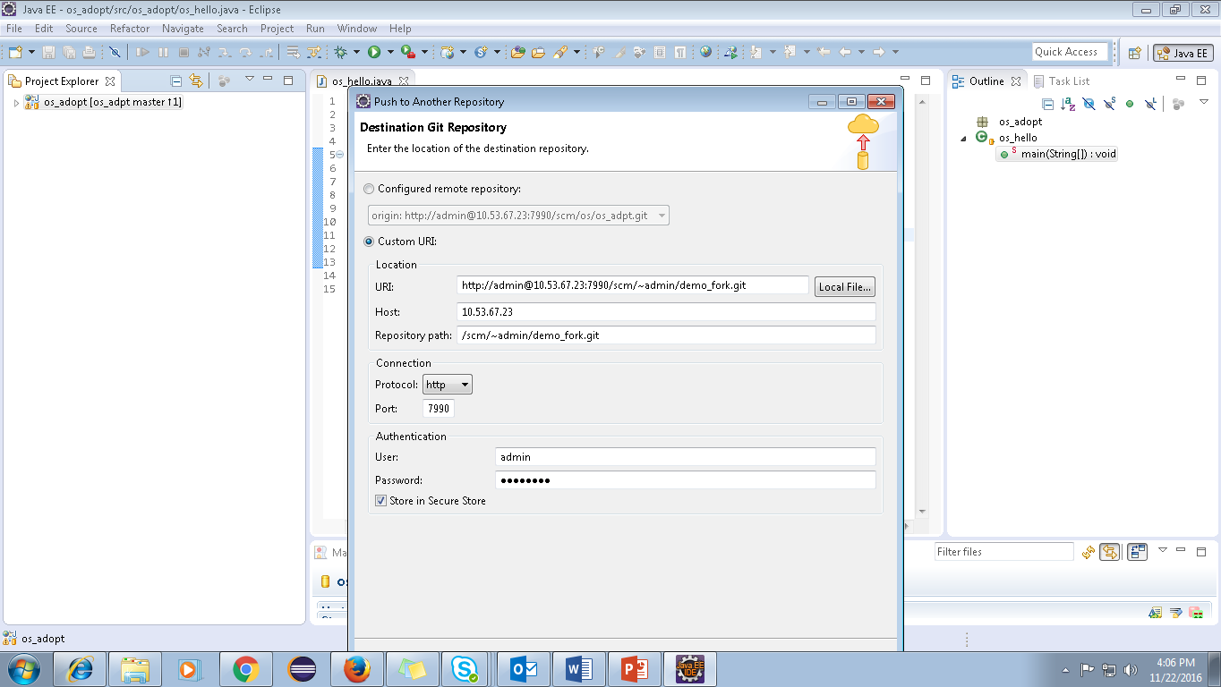

Slide 23
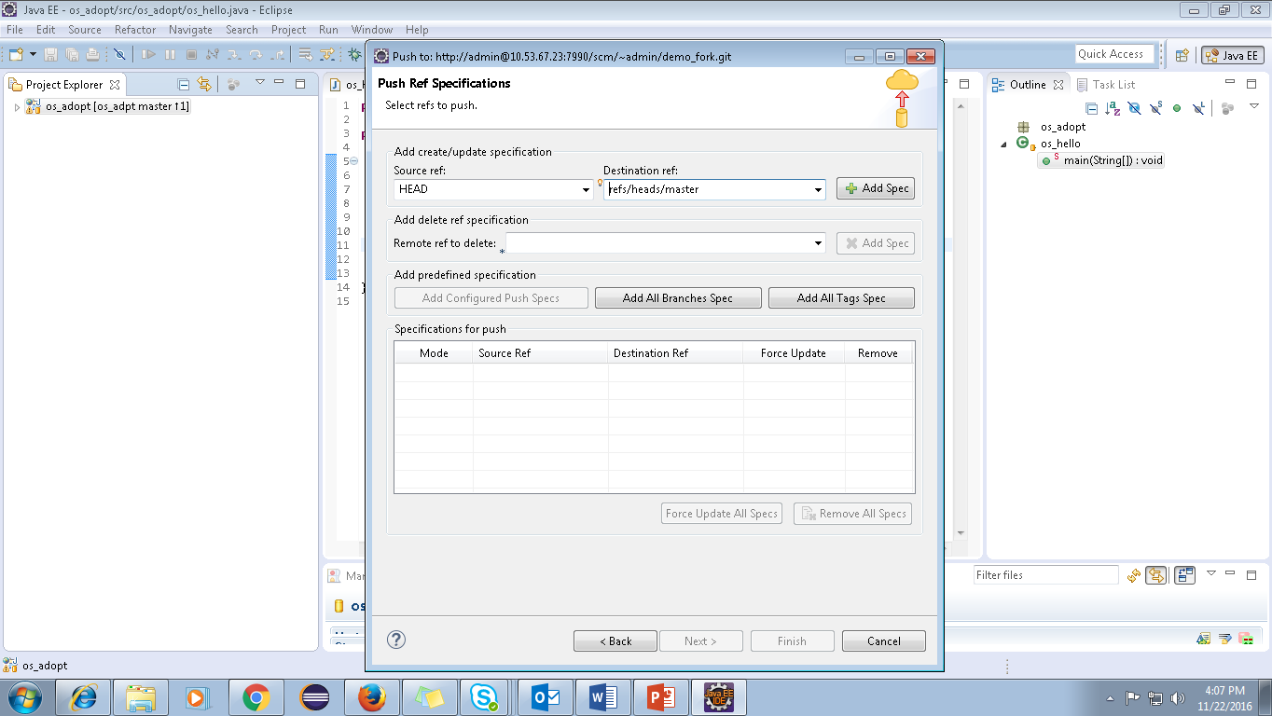

Slide 24
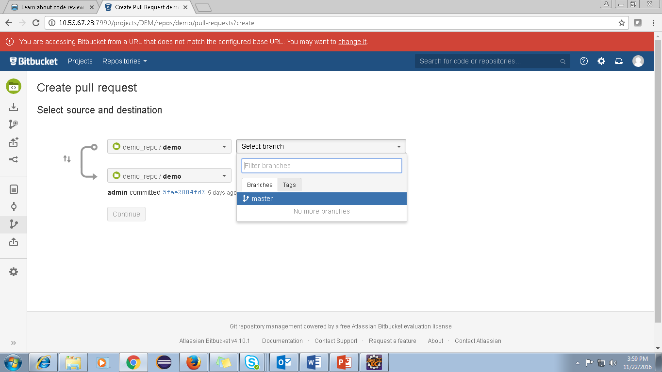
Create a pull request from the original repository you forked to add the changes you made.

Slide 25
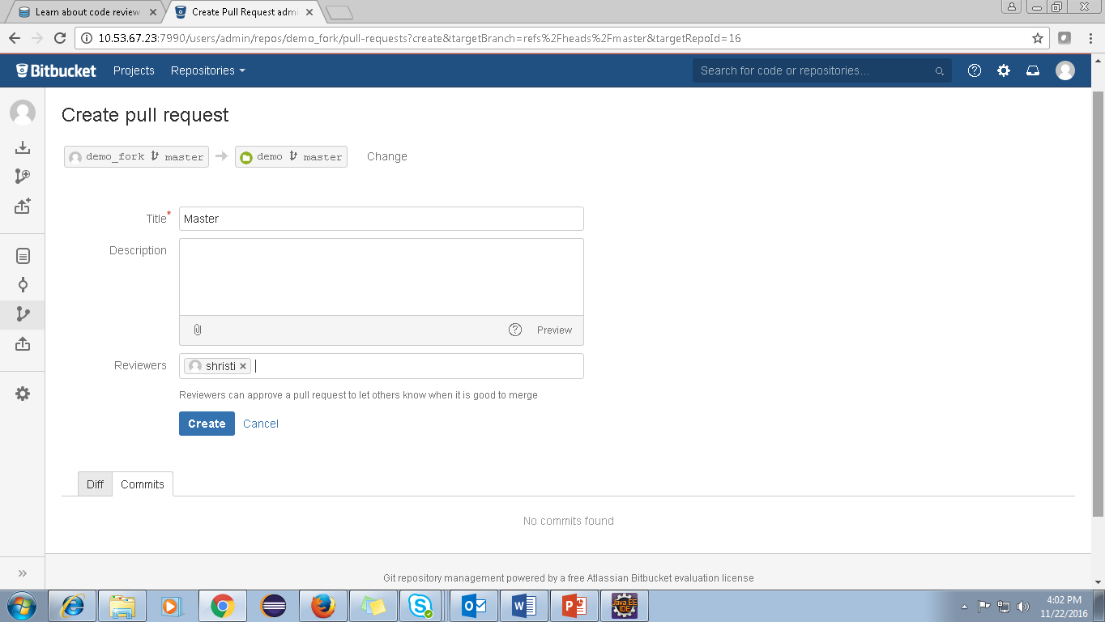
Wait for the repository owner to accept or reject your changes.

Slide 26
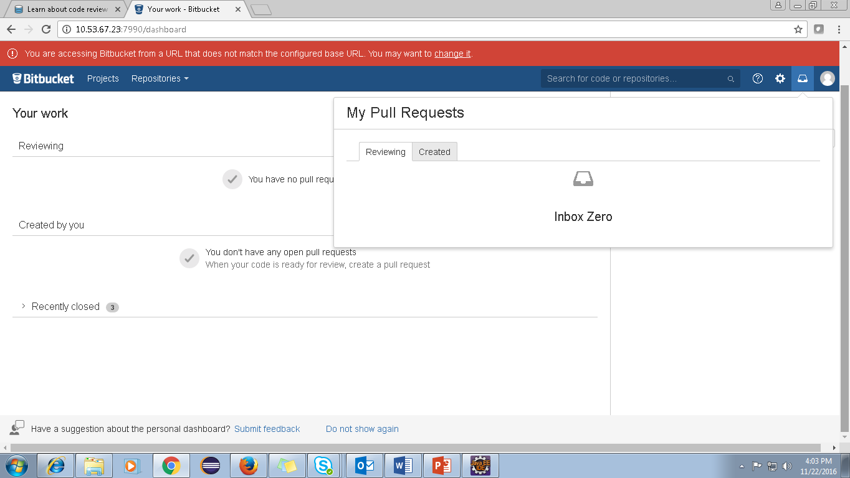
Login as reviewer and approve.
Finally login as admin and click merge.

Slide 27

Conclusion → Bitbucket has over one million users. →The flexibility of Bitbucket and its free private repositories make up for its social shortcomings and its lack of affection in the open source community. →Bitbucket allows us to log in with Twitter, Google, Facebook, OpenID, and GitHub credentials while its counterparts such as GitHub do not provide such external authentication for its users. →BitBucket has a better pricing model for small teams of single developers. Bitbucket is a better product compared to GitHub, but the main feature that made GitHub more popular was the early support for Git.

Slide 28
Thank you
Visit us at www.techmahindra.com

Slide 30

30

Slide 31

31

Slide 32

32

Slide 33

33

Slide 34

34

Slide 35

35

Slide 36


Slide 37


